Slide 1




NEXT GEN EMPLOYABILITY PROGRAM
Creating a future-ready workforce
Team Members
College Name
Student Name : INDHUMATHI D
Student ID : 623521104023
6235 - AVS College of Technology

Slide 2

CAPSTONE PROJECT SHOWCASE
Project Title
Building Bus Reservation System using Python and Django
Abstract | Problem Statement | Project Overview | Proposed Solution | Technology Used | Modelling & Results | Conclusion

Slide 3
Abstract
Aimed at facilitating the booking and management of bus tickets, providing convenience and efficiency to users.
Key features include user registration/authentication, bus and route management, seat reservation, payment integration, and reservation management.
Users can create accounts, log in securely, and search for available buses based on route, date, and time.
Source :

Slide 4
Problem Statement
Booking processes are often complex and time-consuming, leading to inconvenience for passengers and potential loss of business for operators.
Passengers face difficulty in accessing accurate and up-to-date information about available buses, routes, and seat availability, hindering effective travel planning.
Integration with payment gateways is often unreliable, resulting in payment failures and frustration for users.
Reservation management features are inadequate, leading to overbooking, conflicts, and customer dissatisfaction.
Administrative tools for managing buses, routes, and bookings are insufficient, causing inefficiencies and missed optimization opportunities.
Source :

Slide 5
Project Overview
The primary goal of the project is to create a user-friendly and efficient platform for booking bus tickets, providing accurate information to passengers, and empowering bus operators with effective management tools.
User Authentication: Users can register, log in securely, and manage their accounts.
Bus and Route Management: Administrators can add, edit, and delete bus routes, along with specifying details such as capacity, schedule, and fare.
Source :

Slide 6
Proposed Solution
Develop a comprehensive Bus Reservation System (BRS) using Python and Django framework to streamline the booking process and enhance reservation management.
Key Components:
Seat Reservation
Payment Integration
User Management
Bus and Route Management
Reservation Management
Source :

Slide 7
Seat Reservation: Passengers can search for available buses based on route, date, and time, select seats, and make reservations.
Payment Integration: Integration with payment gateways allows secure online payments for reservations.
Reservation Management: Users can view reservation history, modify or cancel bookings, and receive email notifications for updates.
Admin Dashboard: Administrators have access to a dashboard for monitoring bookings, managing buses and routes, and generating sales reports.
Source :

Slide 8


Technology Used
Front-end
Back-end
Source :

Slide 9
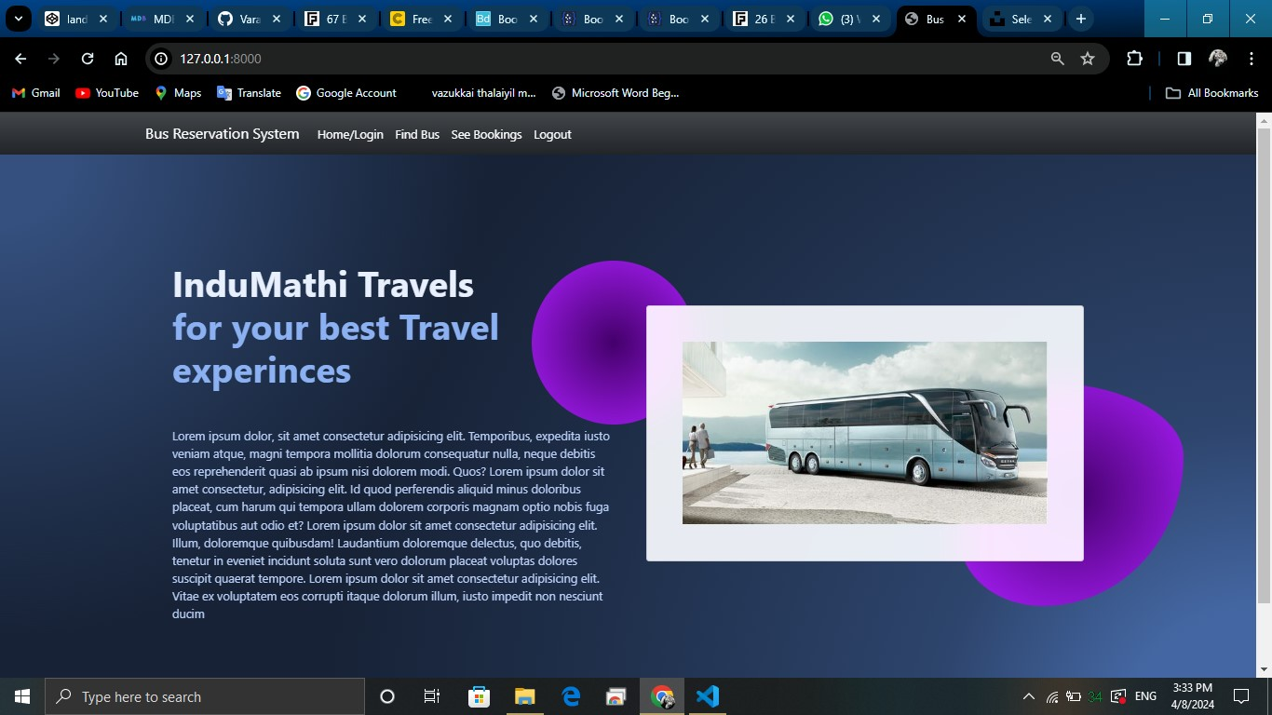
Modelling & Results
Source :

Slide 10
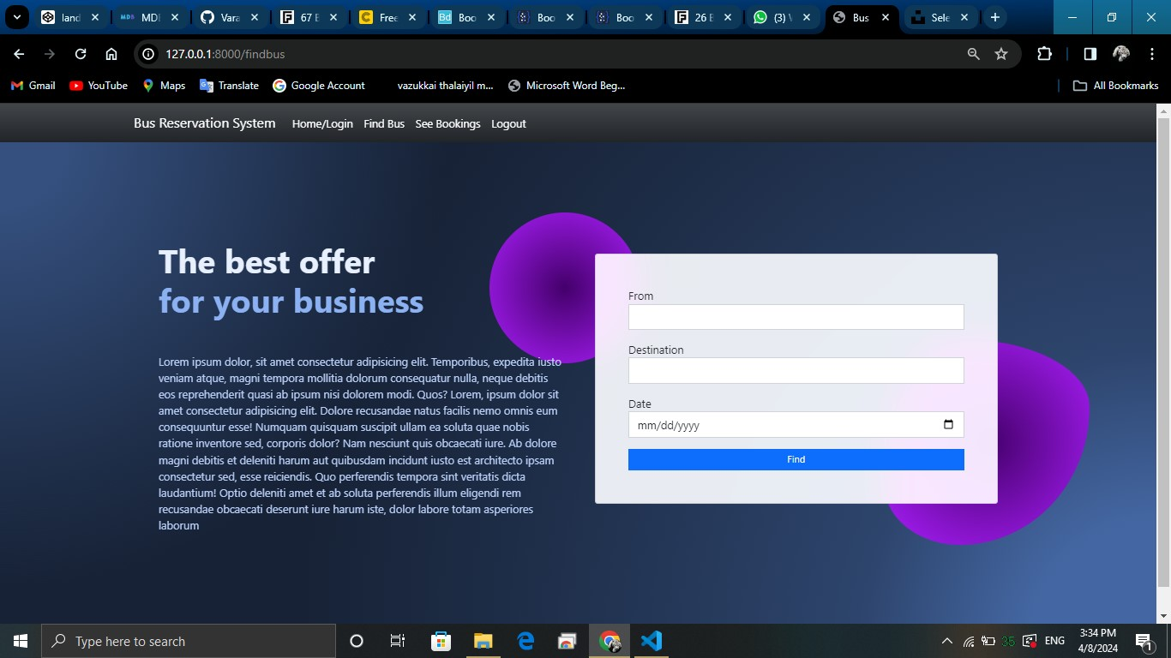
FIND BUS

Slide 11
HOME PAGE

Slide 12
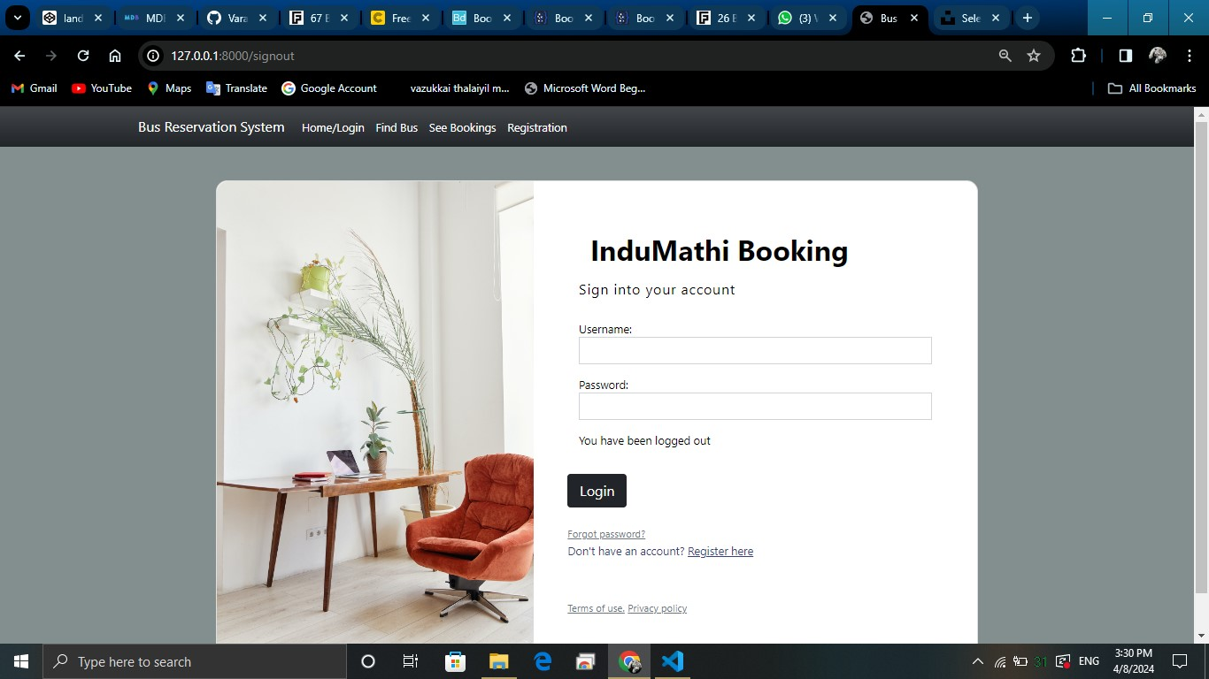
LOGIN PAGE

Slide 13
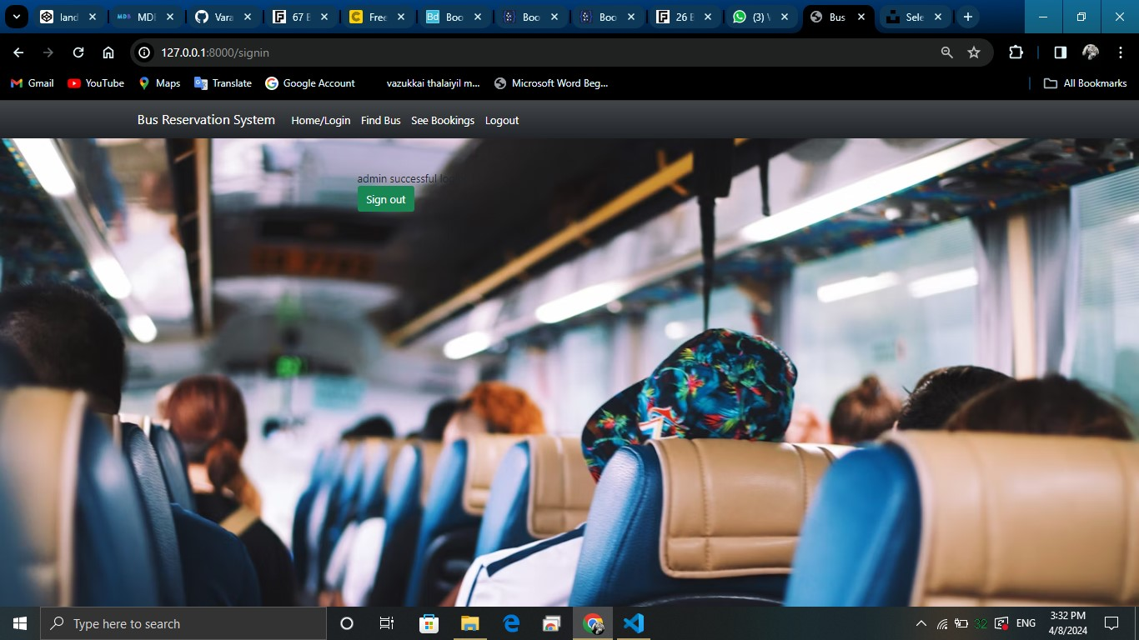
THANKS PAGE

Slide 14
Future Enhancements:
Enhance accessibility features for users with disabilities.
Introduce QR code or RFID-based ticketing systems.
Promote environmental initiatives for sustainable travel.
Implement IoT sensors for predictive maintenance.
These enhancements aim to improve the overall functionality, user experience, and sustainability of the Bus Reservation System.

Slide 15
Conclusion
In conclusion, the proposed Bus Reservation System (BRS) offers a comprehensive solution for efficient bus ticket booking and management. By leveraging Python and Django framework, the system streamlines the booking process, enhances reservation management, and provides a seamless experience for both passengers and bus operators.
With key features such as user authentication, bus and route management, seat reservation, payment integration, and admin dashboard, the BRS caters to the diverse needs of users while empowering administrators with effective tools for bus management and analytics.
Source :

Slide 16
Thank You!
Notes:
Thank You !!

